Slide 1

Lesson-4
李明晓 开课吧人工智能学院课程组
2020.02

Slide 2

Deep learning and backpropagation
Deep Learning
What is perception and deep learning ?
Why deep learning is popular now ?
An example (Logistic regression)
Active functions and cost functions.
Backpropagation
Computation graph (an simple example)
Forward propagation and backward propagation in DL.
Parameters initialization.

Slide 3
Deep Learning
Reference: Deep Learning chapter 6

Slide 4
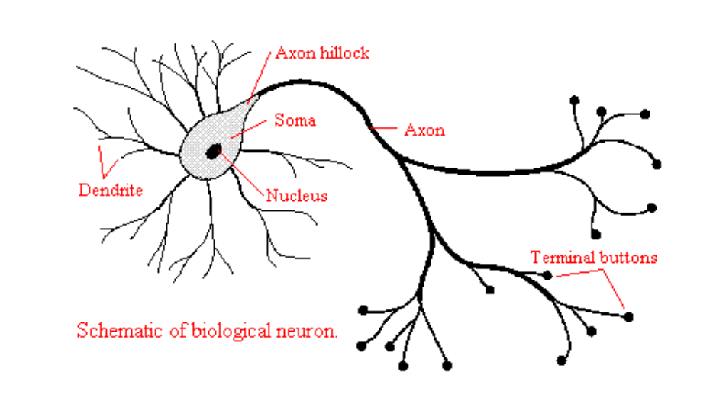
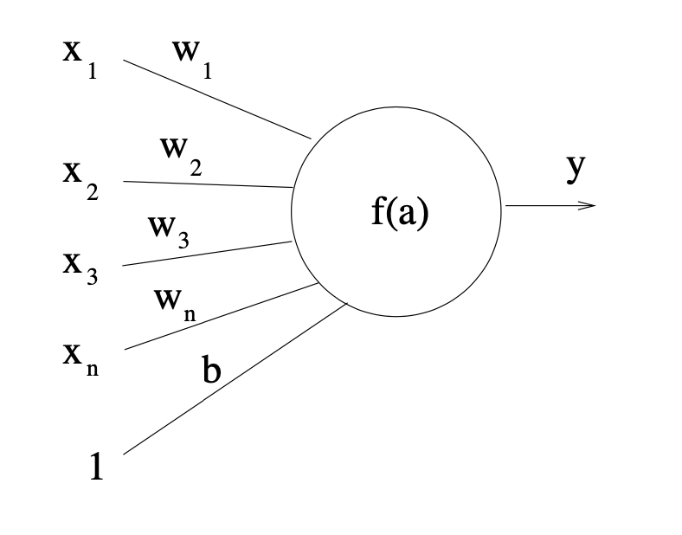
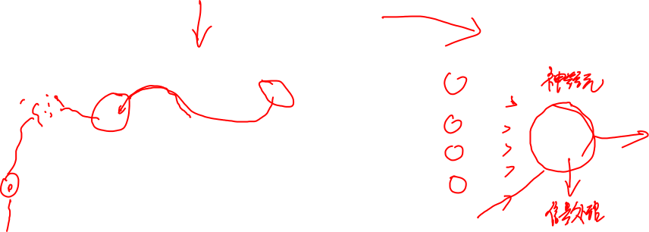
Neuron
A neuron has three main parts: - neuron cell body - branching extensions called dendrites for receiving input - an axon that carries the neuron’s output to the dendrites of other neurons

Slide 5

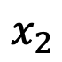


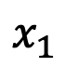

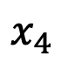

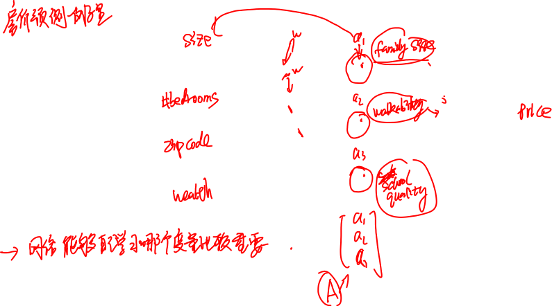
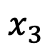

What is neural networks ? (an example)
size
$$x_{1}$$
#bedrooms
$$x_{2}$$
y
zip code
$$x_{3}$$
wealth
$$x_{4}$$

Slide 6
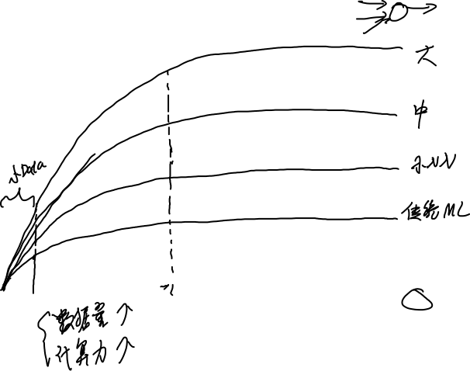
Why is DL popular now ?
Peformance
Data

Slide 7
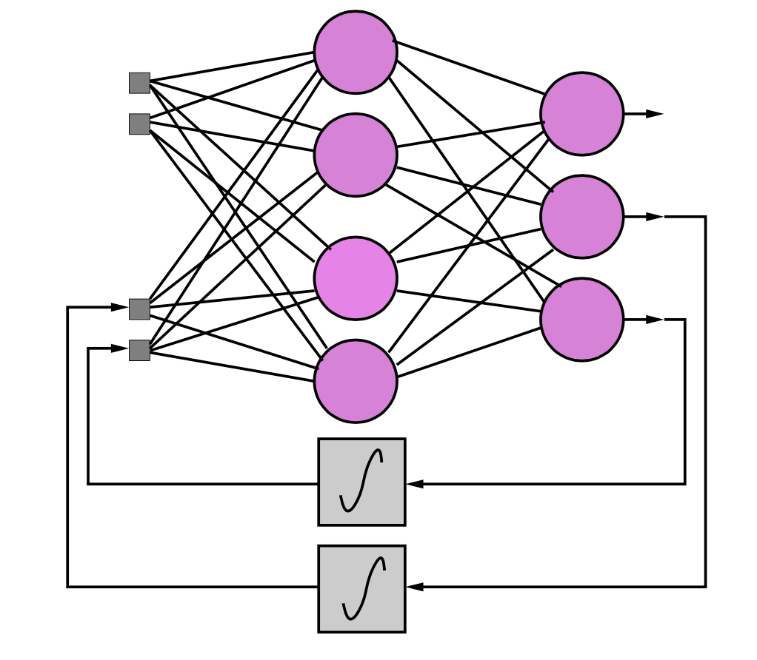
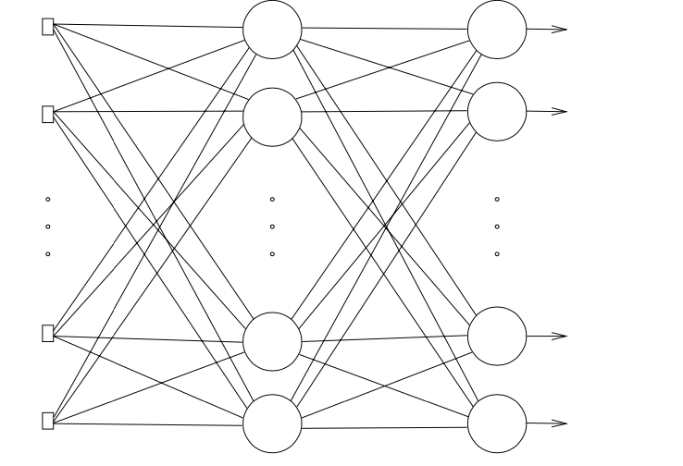
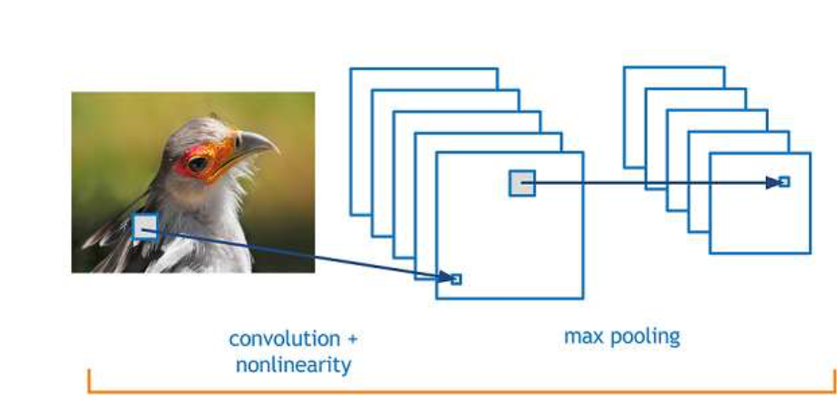
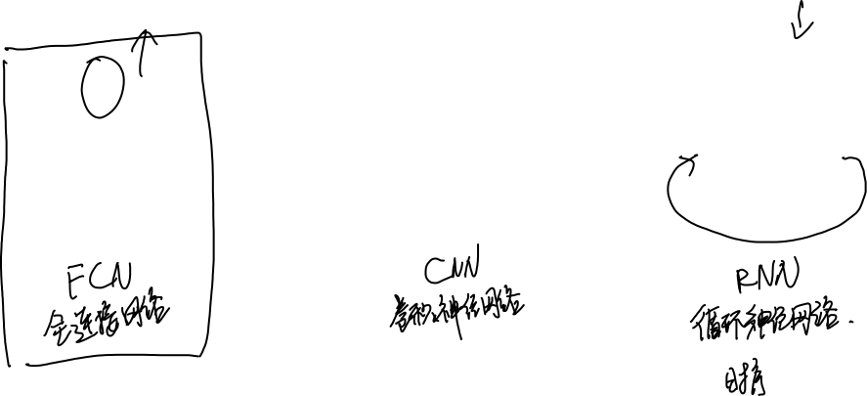
From neuron to deep neural networks

Slide 8
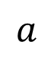

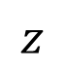
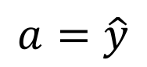
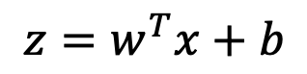
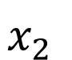
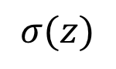
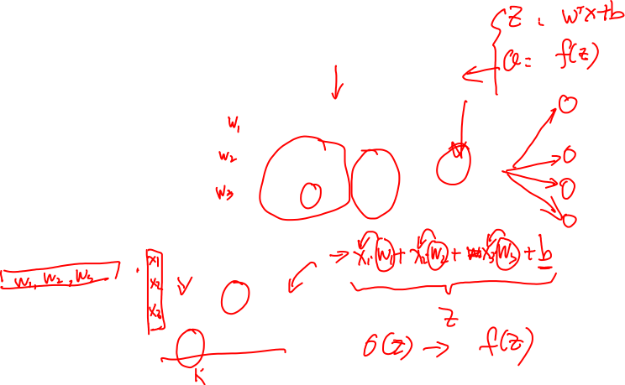
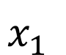
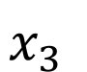
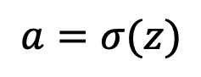
Computation within a neuron
$$x_{1}$$
$$x_{2}$$
$$σ(z)$$
$$a=\hat{y}$$
$$w^{T}x+b$$
$$z$$
$$a$$
$$x_{3}$$
$$z=w^{T}x+b$$
$$a=σ(z)$$

Slide 9
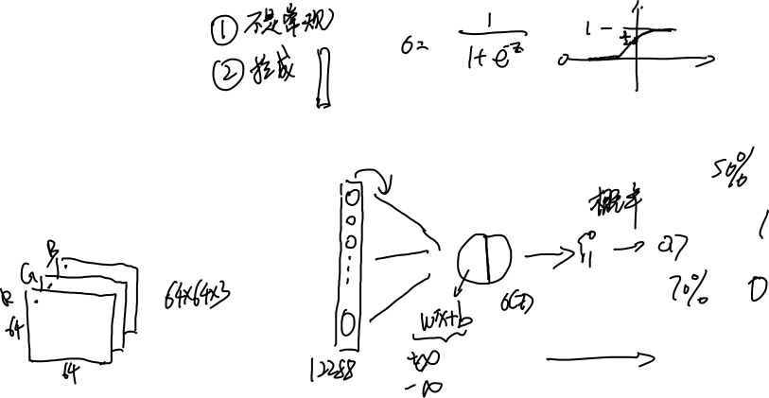
Logistic regression. (An example of binary classification)
1 (cat) vs 0 (non cat)
Blue
Green
Red

Slide 10
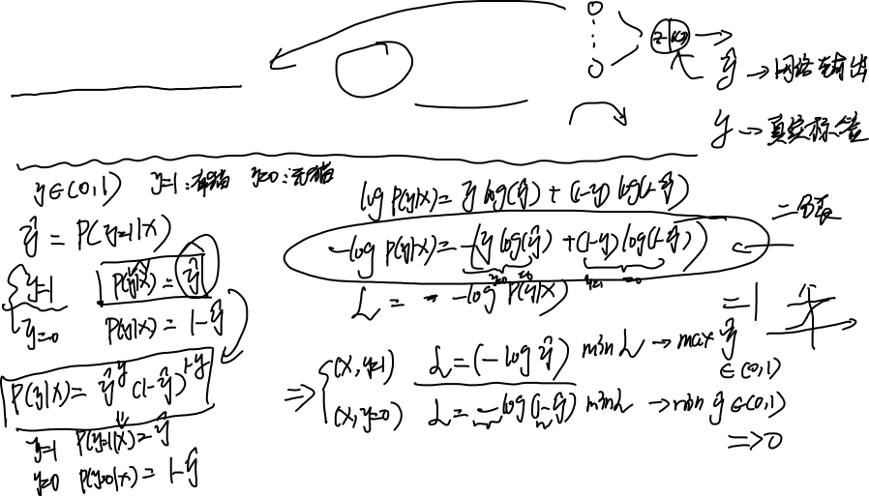
Logistic regression
$\hat{y} = σ\left(w^{T}x +b\right)$, where $σ\left(z \right)=\frac{1}{1+e^{−z}}$
Given $\left\{{(x}^{(1)},y^{(1)}\text{)}\text{,}\text{…}\text{,}{(x}^{(m)},y^{(m)}\text{)}\right\},$want ${\hat{y}}^{(i)}≈y^{\left(i\right)}$.
Loss (error) function:

Slide 11
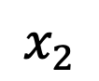
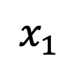
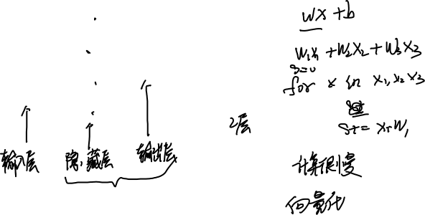
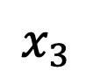
Forward propagation in NN.
$$x_{1}$$
$$x_{2}$$
$$\hat{y}$$
$$x_{3}$$

Slide 12
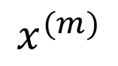
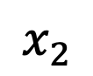
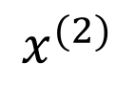
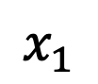
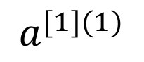
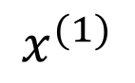
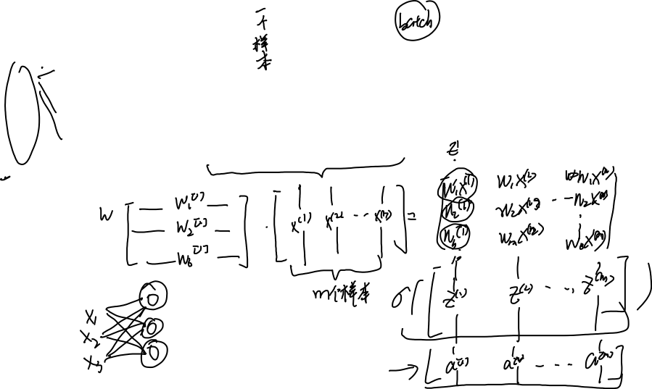
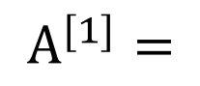
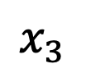
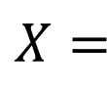
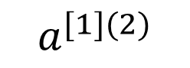
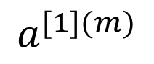
Vectorization
$$x_{1}$$
$$x_{2}$$
$$X=$$
$$x^{(1)}$$
$$x^{(2)}$$
$$x^{(m)}$$
$A^{[1]}=$
$$a^{[1](1)}$$
$$a^{[1](2)}$$
$$a^{[1](m)}$$
$$\hat{y}$$
…
…
$$x_{3}$$

Slide 13
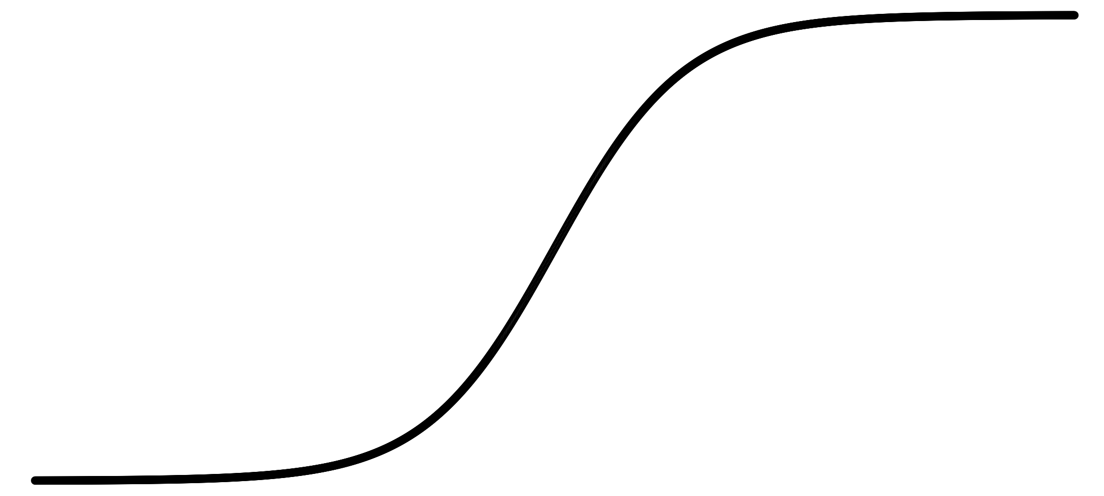
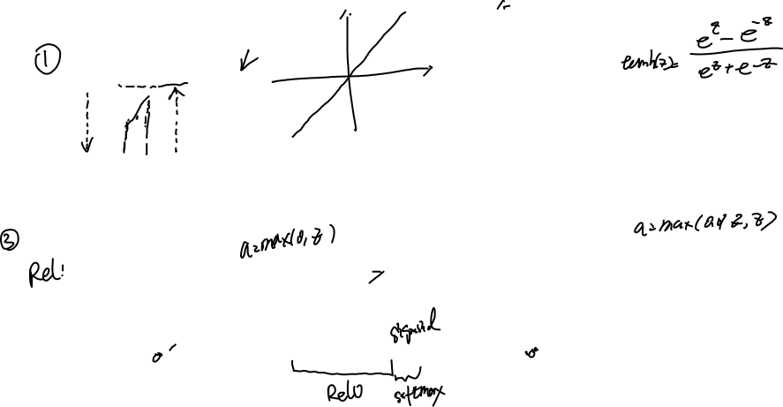
Activation functions and cost function
Some Activation functions
a
a
x
z
$$a= \frac{1}{1+e^{−z}}$$
sigmoid:
a
a
z
z

Slide 14
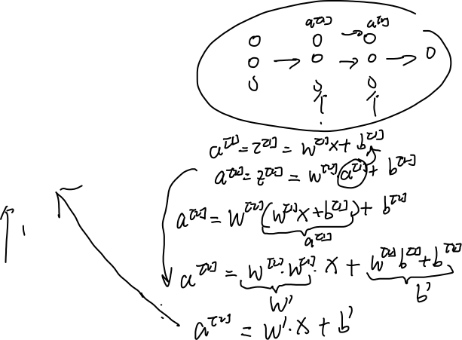
Why no-linear activation function ?
$$x_{1}$$
$$x_{2}$$
$$\hat{y}$$
$$x_{3}$$

Slide 15
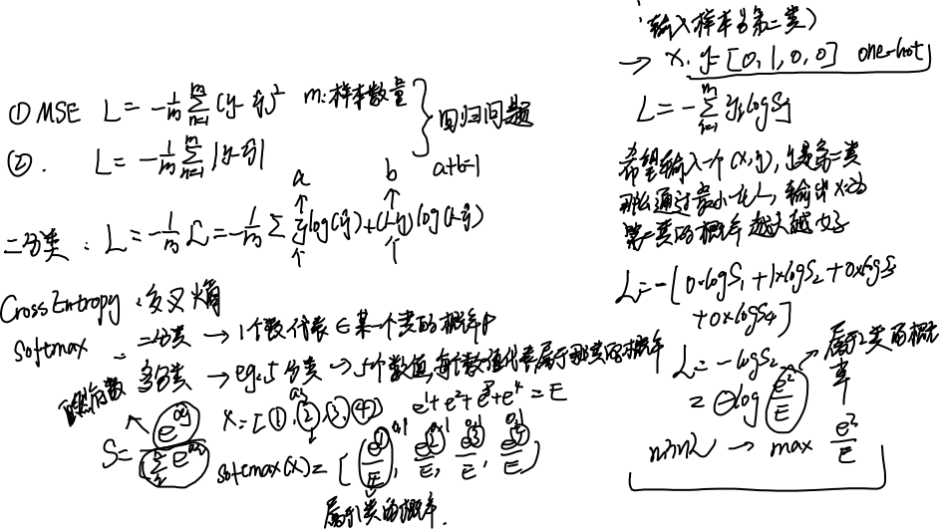
Cost functions.

Slide 16


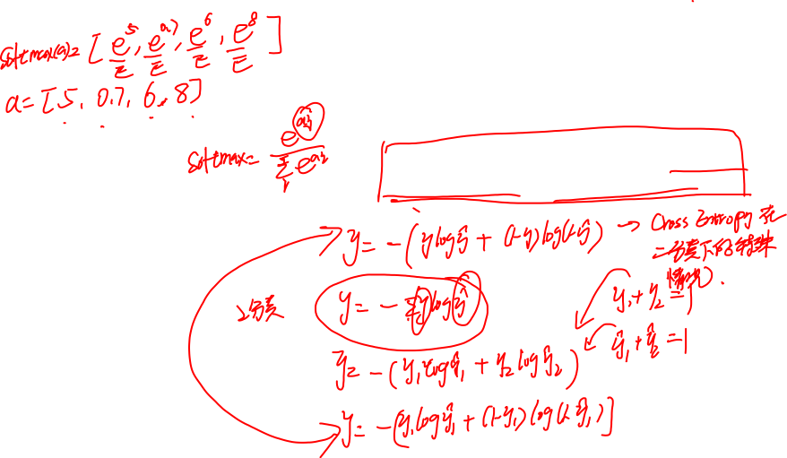
Test your understanding
What is the relationship between logits regression loss and cross entropy ?

Slide 17
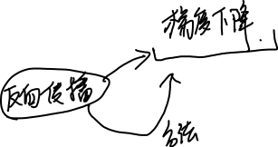
BP

Slide 18
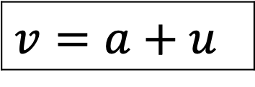
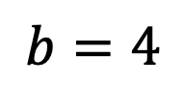
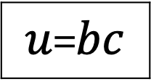




Computation graph (Forward)
$$a=6$$
$$b=4$$
$$v=a+u$$
$J=5v$
$u$=$bc$
$$c=2$$

Slide 19










Computation graph (Backward)
$$a=6$$
$$b=4$$
$$v=a+u$$
$J=5v$
$u$=$bc$
$$c=2$$

Slide 20












Backpropagation along NN
$$W^{[2]}$$
$$x$$
$$b^{[2]}$$
$$W^{[1]}$$
$$z^{[1]}=W^{[1]}x+b^{[1]}$$
$$a^{[1]}= σ(z^{[1]})$$
$$z^{[2]}=W^{[2]}x+b^{[2]}$$
$$a^{[2]}= σ(z^{[2]})$$
$$ℒ(a^{[2]},y)$$
$$b^{[1]}$$

Slide 21










$$W^{[2]}$$
$$x$$
$$b^{[2]}$$
$$W^{[1]}$$
$$z^{[1]}=W^{[1]}x+b^{[1]}$$
$$a^{[1]}= σ(z^{[1]})$$
$$z^{[2]}=W^{[2]}x+b^{[2]}$$
$$a^{[2]}= σ(z^{[2]})$$
$$ℒ(a^{[2]},y)$$
$$b^{[1]}$$

Slide 22

Why no zero initialization ?
$$x_{1}$$
$$a_{1}^{[1]}$$
$$a_{1}^{[2]}$$
$$\hat{y}$$
$$x_{2}$$
$$a_{2}^{[1]}$$

Slide 23

Random initialization.
$$x_{1}$$
$$a_{1}^{[1]}$$
$$a_{1}^{[2]}$$
$$\hat{y}$$
$$x_{2}$$
$$a_{2}^{[1]}$$

Slide 24

SGD

Slide 25

Thanks for your attending

